Slide 1
CLEANING ACTION ROVINJ
RED ISLAND – HOTEL ISTRA

Slide 2
PADI AWARE
PADI AWARE Foundation is a publicly funded non-profit with three registered charities across the globe. Thieir mission is to drive local action for global ocean conservation. They advance their mission through citizen science, public policy and community grants. With PADI - the world's leading scuba diver training organization - we drive towards our collective vision to achieve balance between humanity and the ocean.

Slide 3
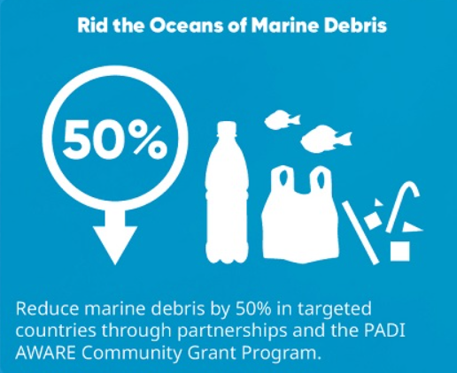
For over 30 years, PADI and AWARE have built a truly unique voice for the protection of the underwater world. PADI AWARE Foundation can fully leverage the collective influence of divers and the dive industry to address key threats facing the marine environment.

Slide 4
Diveworld Hungary as a PADI 5 Star Dive Center is an official partner of Project Aware

Slide 5
DIVEWORLD TEAM
Diveworld Hungary and its team are committed to the environment and have been doing a lot to protect the marine environment for years. Within the framework of the Padi Project Aware and with the support of the Island Hotel Istra, the company has been cleaning the sea of accumulated garbage at the beginning of the season for years.

Slide 6
HOTEL ISTRA
Diveworld Hungary and its team are committed to the environment and have been doing a lot to protect the marine environment for years. Within the framework of the Padi Project Aware and with the support of the Island Hotel Istra, the company has been cleaning the sea of accumulated garbage at the beginning of the season for years.

Slide 7
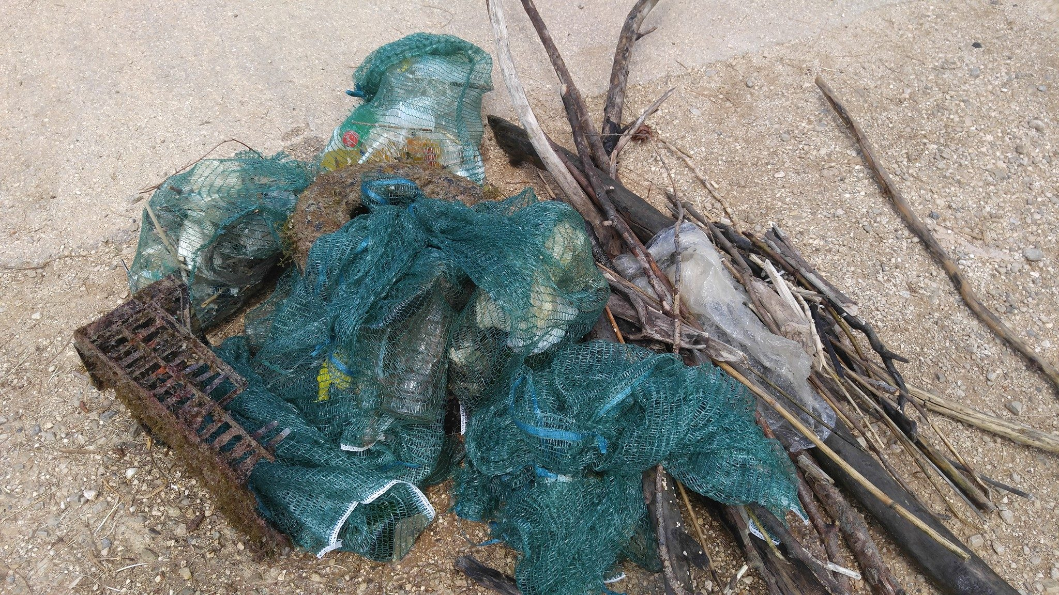
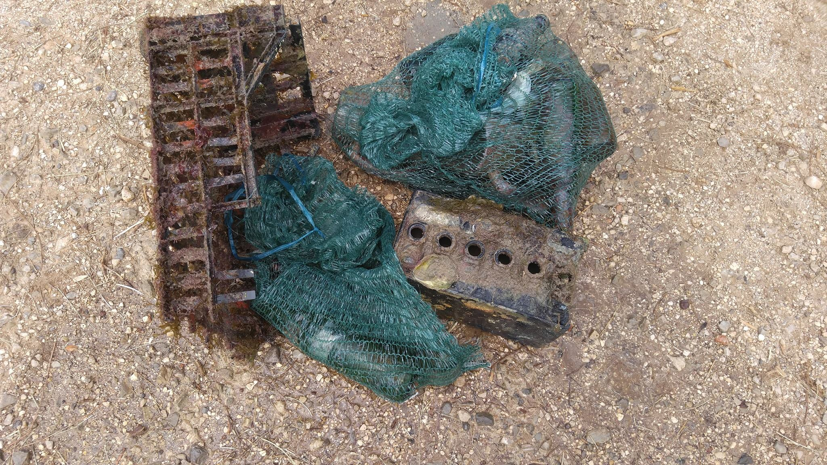
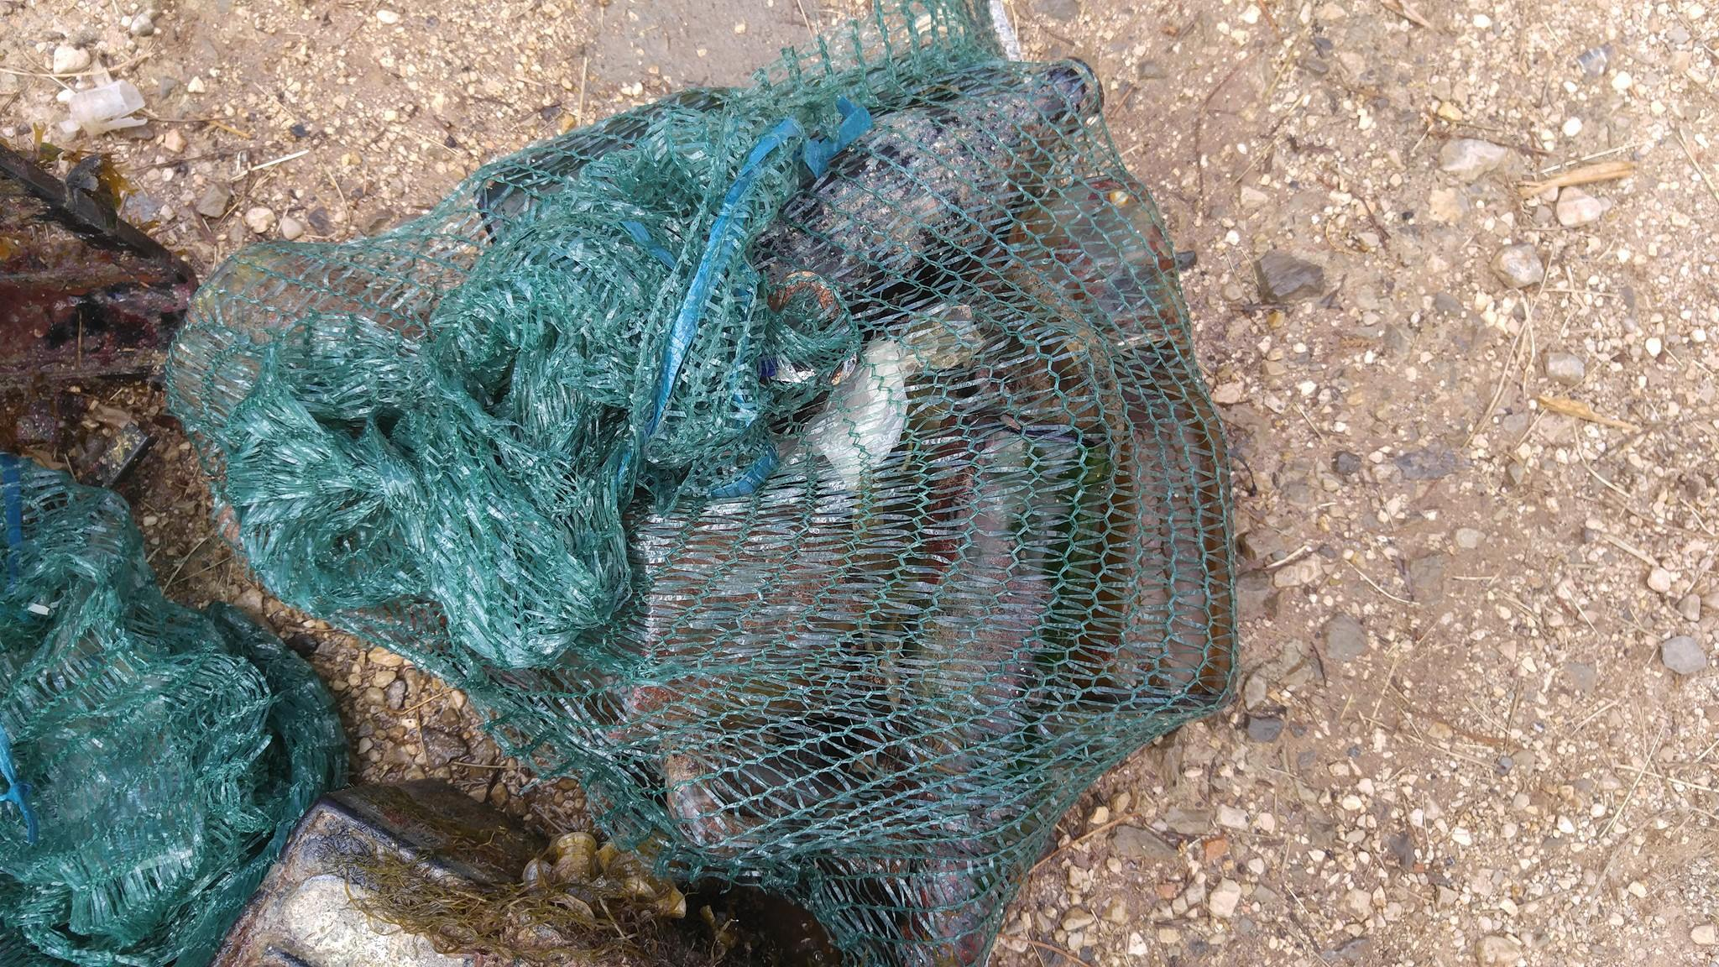
8 years – HOTEL ISTRA
For about 8 years, with the support of the Island Hotel Istra, several dive teams have been diving off the coast of the island specifically to pick up litter and collect significant amounts of trash out of the water.

Slide 8
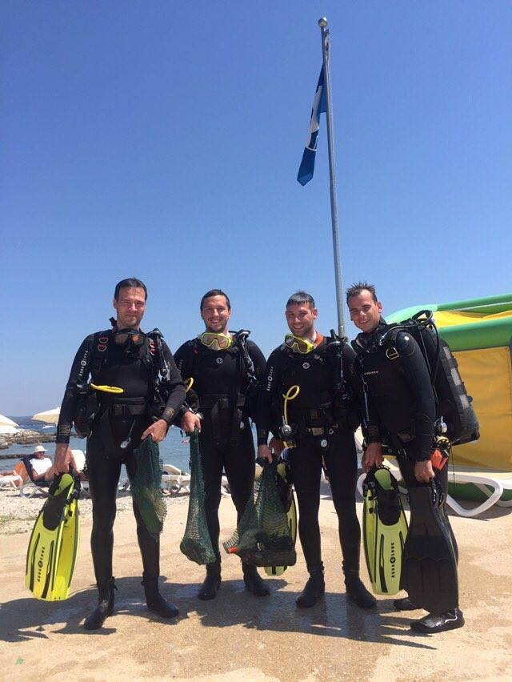
Our team during the cleaning action

Slide 9
the procedure of the cleaning action:
Diveworld Hungary team promotes the cleaning aciton supported by Island Hotel Istra all year
divers arrive on site and receive special equipment provided by Island Hotel Istra
official briefing, during which the areas to be cleaned are identified in cooperation with the hotel staff
litter picking underwater
with the help of hotel staff and the hotel's boat, lifting bags full of rubbish from the water and taking them ashore
hotel arranges for the removal of the collected rubbish
official closing ceremony

Slide 10
DIVEWORLD TEAM
info@diveworld.hu www.diveworld.hu

